Slide 1
Writing SMART outcomes and SEND Support Plans
Specialist Teaching and Advisory Service Halton Borough Council

Slide 2
Session aims today:
To raise awareness/ remind staff of the graduated approach
To support practitioners in writing effective outcomes for SEND Support Plans
For practitioners to be familiar with the ‘SEND Strategy Toolkit’

Slide 3
Definition: What is SEND?
“A pupil has SEND where their learning difficulty or disability calls for special educational provision, namely provision different from or additional to that normally available for pupils of the same age.” 6.15

Slide 4
Categories of need
Social, emotional and mental health difficulties
Anxiety, depression, self-harming, substance misuse, eating disorders, physical symptoms that are medically unexplained
Attention deficit disorder
Attention deficit hyperactivity disorder
Attachment disorder
Communication and Interaction
Autism Spectrum Disorder
Speech, Language and Communication Needs
Cognition and Learning
Moderate Learning Difficulties
Severe Learning Difficulties
Profound and Multiple Learning Difficulties
Specific Learning Difficulties (dyslexia, dyscalculia, dyspraxia)
Sensory/ physical
Hearing impaired
Vision impaired
Multi-sensory impairment
Physical disability

Slide 5
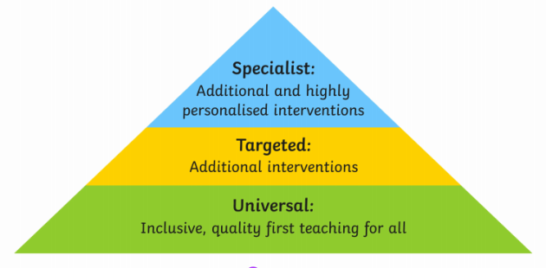
SEND is everyone’s business
All staff are responsible and accountable for the progress and development of the pupils in their class. 6.36
High quality teaching, differentiated for individual pupils, is the first step in responding to pupils who may have SEN. Additional intervention cannot compensate for a lack of good quality first teaching. 6.37

Slide 6
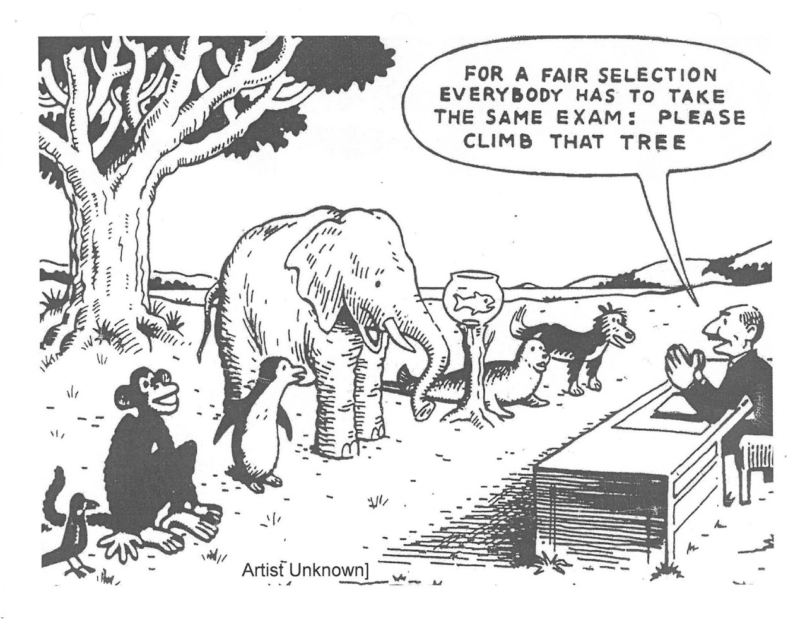
Differentiation! Quality first Teaching
https://www.egfl.org.uk/sites/default/files/Services_for_children/SEND/Differentiation%20Nasen.pdf

Slide 7
What the Code of Practice says…
First response is Quality First Teaching- this is teaching targeted at the child’s area of need.
QFT
Teacher, together with the SENCO assesses whether the child has SEN.
Views of parents and pupils will be sought.
Rigorous intervention and additional teaching.
No delay in intervention
Progress Remains a Concern
Action to remove barriers to learning.
Aim: Secure good outcomes for children.
Support takes the form of a 4 part cycle: Assess, Plan, Do, Review.
SEN Support
The SEND Strategy Toolkit has a whole host of quality first teaching strategies for you to access
Dimensions for learning also has lots of resources https://localoffer.haltonchildrenstrust.co.uk/schools-colleges-post16/useful-information-documents/send-halton-graduated-approach-and-strategy-toolkit/

Slide 8
Assess, plan, do, review
Growing understanding of pupil’s needs
Observe
Use assessment
Identify need
Has the child made progress? Is more needed?
Assess
Plan
Do
Review
Growing understanding of what teaching approaches work
Growing understanding of effective support

Slide 9
I have a child with SEND in my class what do I do?????
Know the child’s strengths and what they enjoy
What is the barrier to their learning, education, functioning?
Gather evidence, observations and information
Make sure you have tried all quality first teaching strategies (strategy toolkit on Halton Local Offer)
Liaise with the SENCO and family
Put together a SEND Support plan which has been agreed by everyone

Slide 10
SEN Support Plans
Strengths
Identified areas of need
Assessment
Clear purpose/ outcomes
Parent views
Pupil
views
Important for
Important to

Slide 11
Outcomes

Slide 12
Misinterpretations!!! Be specific
It is important to avoid using ‘Woolly’ statements that lead to misinterpretations
e.g.
‘Independently’
‘Short periods’
‘Participate’
‘With little support’
‘Engage’

Slide 13
Examples of use of ‘woolly’ terminology and how it leads to outcomes which are not SMART
Bobby will be able to manage his emotional outbursts
Tom will be able to make progress in line with his peers
Toby will work to the best of his ability in all lessons
Alice will independently participate, in a small group activity, for a short period of time.
To develop my listening and attention skills
To dress myself independently
I will establish a positive relationship with my TA
Chloe will be able to keep her hands and feet to herself
Eva will sit on the carpet for Letters and Sounds

Slide 14
Writing SMART: consider the following…
Who? (The CHILD)
Does What? (What do you want the child to be able to do?)
Under what condition? (will prompts be needed)
To what degree of success? (How will we know if they have achieved the target?)
By When? (Set a date for review-this must be regular and realistic to the target)
SMART TARGET:

Slide 15
What do we mean by ‘conditions’-Types of prompts
Physical
Full-hand over hand support
Partial-gentle elbow prompt
Visual
Modelling/video demonstration
Objects of reference/photographs/picture/symbol
Now and next board/working for card/sand timer
Gesturing (Signing/point/nod/smile/frown etc)
Written-lists, timetable
Positional
Verbal
Directions/instruction
Questions
Auditory
Alarm
Timer
Song

Slide 16
‘Alice will independently participate, in a small group activity, for a short period of time’
Who? (The CHILD)
Does What? (What do you want the child to be able to do?)
Under what condition? (will prompts be needed)
To what degree of success? (How will we know if they have achieved the target?)
By When? (Set a date for review-this must be regular and realistic to the target)
SMART Outcome:
Alice
play with 3 other children in a simple turn taking game
with a turn taking board
for 10 minutes
by the end of Spring 1
Alice will play with 3 other children in a simple turn taking game using her turn taking board for 10 minutes by the end of the Spring term.

Slide 17
‘Joshua will develop his fine and gross motor skills’
Who? (The CHILD)
Does What? (What do you want the child to be able to do?)
Under what condition? (will prompts be needed)
To what degree of success? (How will we know if they have achieved the target?)
By When? (Set a date for review-this must be regular and realistic to the target)
SMART Outcome:
Joshua
will be able to button up his school shirt after PE
with some adult modelling
50% of the time
by the end of year 1
Joshua will be able to button up his school shirt after PE, with some adult modelling 50% of the time, by the end of year 1

Slide 19
External agency support
If professionals have identified barriers to learning in their assessments/ reports their targets must be included on a child’s SEND Support Plan.
Your priority as a teacher may be the need to have educational targets and show academic progress, but the SEND Support Plan should be aiming to tackle the child’s primary needs.
It’s their plan, not yours.
Educational Psychology
Specialist Teaching and Advisory Service
Speech and Language Therapy
Halton Behaviour Support Service
Positive Behaviour Support Service
Education Welfare
Occupational Therapy
Physiotherapy

Slide 20
The building blocks for learning
Feeling safe and secure
Understanding and managing emotions
Confidence and self-esteem
Making friends
Using Language
Until we have SEND Support plans that target these needs, children will not learn in the classroom
Understanding language
Listening and attention
Play
Sensory
Physical needs- hunger

Slide 21
Thank you for listening.
For further guidance and support, please visit Halton Local Offer and select Halton Graduated Approach and Strategy Toolkit for more information and guides.
https://localoffer.haltonchildrenstrust.co.uk/schools-colleges-post16/halton-graduated-approach-and-strategy-toolkit/

