Slide 1
A Revised Approach to SEND in the Early Years
Presented by:
Gail Vaughan-Hodkinson – Early Years Team Lead

Slide 2
Outline of Event
What are the current challenges facing SEND in the Early Years?
What are the solutions/ways to move forwards?
- Inclusion Charter
- The role of the Early Years Area SENCO
- Review of Top-up Funding process
- SENCO Buddies
An Introduction to the Autism Education Trust
The Local Offer
- An Introduction to the updated Local Offer
- An introduction to the updated Early Years Graduated Approach
- Halton’s Communication Hub

Slide 3
The Challenges
Increased number of children with SEND being identified
Early Years settings at breaking point
Local Authority budgets continue to be cut
Top-up Funding process
Increased number of applications for EHCP assessments
Changes within Services
Impact of Covid-19
Inclusion

Slide 4
Discussion
In break out groups, discuss the following:-
Do you agree with the challenges outlined above?
What other challenges are you facing?
Can you identify any possible solutions?

Slide 5
What are the solutions/ways to move forwards?

Slide 6
Inclusion
‘Inclusion and equality go hand in hand. An inclusive environment, where equality is upheld and diversity respected, is fundamental to supporting children to build positive identities, develop a sense of belonging and realise their full potential’
(Minister Katherine Zappone, ‘Diversity, Equality and Inclusion Charter and Guidelines for Early Childhood Care and Education’, Department of Children and Youth Affairs 2016, Dublin).

Slide 7
Discussion
In break out groups, discuss the following:-
What do you understand by the term ‘Inclusion’?
What does an inclusive setting look like?

Slide 8
Principles of an Inclusive Culture in Early Years
An inclusive culture involves:
working in partnership and openly communicating with the child’s family;
working in partnership with outside agencies that may be involved with the family. Consent must be given by the child’s parents ;
actively promoting equal opportunities and anti-bias practices, so that all children and families feel included and valued;
having robust policies and procedures – inclusion policy, equal opportunities policy;
recognising and valuing that all children are unique and will develop and learn at their own rate;
encouraging children to recognise their individual qualities and the characteristics they share with their peers;
actively engaging children in making decisions about their own learning;
respecting the diversity of the child, their family and community;
understanding that children have individual needs, views, cultures and beliefs, which need to be treated with respect and represented throughout the early childhood services;
reflecting on your own attitudes and values.

Slide 9
Early Years Inclusion Charter - Activity
In break out groups, devise a series of statements to go under the following heading :-
An Inclusive Early Years Setting will …….

Slide 10
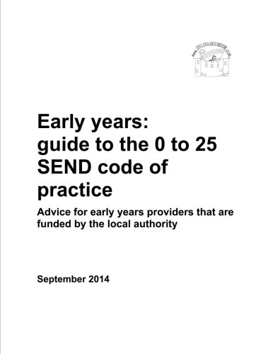
The Role of the Early Years Area SENCO
In the SEND Code of Practice it states:-
‘To fulfil their role in identifying and planning for the needs of children with SEN, local authorities should ensure that there is sufficient expertise and experience amongst local early years providers to support children with SEN. Local authorities often make use of Area SENCOs to provide advice and guidance to early years providers on the development of inclusive early learning environments. The Area SENCO helps make the links between education, health and social care to facilitate appropriate early provision for children with SEN and their transition to compulsory schooling’. (5.55)

Slide 11
The Role of the Early Years Area SENCO
Historically the role of the Early Years Area SENCO was carried out by a team of Consultant Teachers;
The role now sits within the Early Years Team and is shared between Karen Hardman, Andrea Corcoran, Claire Lomax and Gail Vaughan-Hodkinson;
To access support from the EY Area SENCO, email eysendco@halton.gov.uk
The role is very specific and separate from that carried out by the specialist services.

Slide 12
The Role of the Early Years Area SENCO
The role of the Area SENCO includes:
Providing advice to early years settings about approaches to identification, assessment and intervention within the SEN Code of Practice and Early Years Graduated approach;
Providing advice to SENCOs to ensure arrangements are in place to support children with SEN;
Supporting the development and dissemination of good practice through SENCO cluster group meetings and relevant training;
Working with existing SENCOs to support smooth transitions;
Signposting SENCOs to local impartial information, advice and support services, to promote effective work with parents of children in the early years;
Working with SENCOs to promote an inclusive approach; putting into practice the principles outlined in the Early Years Inclusion Charter.

Slide 13
SENCO Buddies
Alongside the role of the EY Area SENCO we are looking to ‘recruit’ experienced EY SENCOs to provide some peer on peer support to settings.
SENCOS who are interested in providing this support will receive training, which will be accredited, and the LA will cover the cost of any training and any costs to your setting, such as backfill costs for staff.
Our aim in creating a team of experienced and highly skilled ‘SENCO’ Buddies is to provide some ‘on the ground’ support for other SENCOs and settings.

Slide 14
Top-Up Funding
The process needs to be reviewed as it is no longer meeting the needs of children in our EY sector effectively or efficiently;
The process is very time-consuming, both at setting and LA level. Paperwork is burdensome and isn’t always filled in appropriately and doesn’t always portray the needs of the child adequately;
The Top Up Funding panel meets 3 times a year. Is this sufficient or should we be looking at either meeting more frequently or doing things in a completely different way?
Where funding is awarded, there is no accountability. We need to be able to ensure that funding is used appropriately and that impact can be measured.

Slide 15
Next Steps?
To work with EY settings to complete the EY Inclusion Charter
To set up a SENCO Buddy system
To set up a working party to review the Top-up Funding process;
Training
SENCO Cluster groups – Tuesday 2nd November 9.30 – 11.00 am & Thursday 4th November 3.30 – 5.00 pm
Official launch of Halton’s Communication Hub

Slide 16
And finally …..
Thank you for attending

