Slide 1
Life after COVID-19:
According to research many children and young people find it unsettling and stressful to transition between schools.
Following the public health crisis and the subsequent period of social isolation is likely that many children and young people have experienced similar feelings as they try to adjust to settling back into school.
Some children are particularly at risk including those who are vulnerable those will have special educational needs or disabilities and those who are moving to a new school.

Slide 2
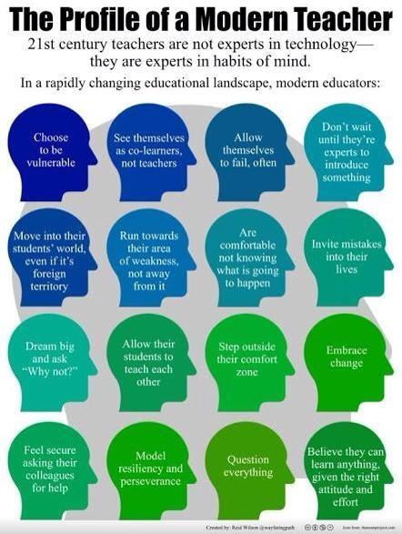
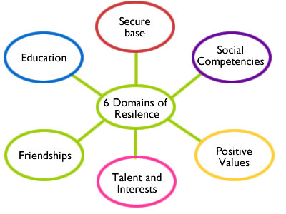
How To Promote Resilience In Your Students Building resilience in your students takes time and a holistic approach. As teachers there is much we can do to promote resilience in our students that will contribute to better outcomes academically, socially and emotionally.

Slide 4
Five ways teachers can promote mental health and resilience in students and classrooms: | Good practice examples
Build positive relationships. A focus on the importance of positive teacher/ student enhances student wellbeing and achievement. A meta-analysis of 99 studies showed that student teacher relationships were linked to student engagement and achievement Roorda et al (2011) and a positive relationship with one caring adult can change the trajectory for even the most at risk student (Anderson, et al, 2004). | The studies show that relational skills such as building relationships, effective classroom management and clear expectations as well as pedagogical factors such as effective instruction, teacher passion and autonomy all contribute to student engagement and achievement.
2.Teach social and emotional skills. Durlak and Wiesberg et al (2011) meta-analysis of social and emotional learning programs (SEL), showed that schools with SEL achieved better academic results than schools without SEL. A whole school approach is ideal, but if your school is not at that stage, there is a great deal that a teacher can do in their classroom. | Explicitly teach in ways which encourage students to collaborate in groups, work in pairs and as an individual and understand the interaction process considering what went well, what could have been better, personal responsibility and awareness. Improve peer relationships by explicitly teaching skills of self-awareness, self-management, social awareness, relationship skills and responsible decision-making. Resources are available on websites such as CASEL (Collaborative for Academic and Social and Emotional Learning), Kidsmatter and the Building Resilience online portal (education.vic.gov.au/resilience). The most effective programs are sequential, use active learning, focus on skill development and have explicit learning goals. The use of collaborative learning strategies is vital to reinforce the skills and provide opportunities for students to practice social skills.
3. Foster positive emotions by building a sense of pride and belonging within the school. School connectedness is a strong protective factor for health and academic outcomes for all students (Wingspread Declaration on School Connectedness, 2001; Roffey, 2012). When respectful behaviour is valued and modelled and students feel they have a voice, schools can build a sense of belonging and connectedness with even the most at risk students. | Create a positive learning environment where students have a voice and choice, ensure that all students feel physically and emotionally safe and use collaborative learning strategies to enhance student relationships. A proactive approach will help to reduce anxiety and improve learning outcomes.
4. Identify student strengths. In the past education has focused on a deficit model when dealing with students who do not achieve. We looked at how we could ‘fix’ those students. | A strengths based approach that identifies student abilities and positive qualities then works proactively to build upon these strengths, gives your students more opportunities to be successful and build a strong sense of self-worth.
5. Build a sense of meaning and purpose. Providing opportunities for students to contribute to others gives meaning beyond themselves. | Engage your students with the local and global community so they find ways to contribute. Working towards worthwhile goals increases students sense of wellbeing which impacts positively on student achievement. Create opportunities for students to experience altruistic activities where they support others in school- such as reading mentors, buddy mentoring.

