Slide 1
Special school competitions

Slide 2
Agenda
Introductions
About New Schools Network
Special free schools: the basics
The special free school application process
How New Schools Network can help you
Questions

Slide 3
About New Schools Network
Independent charity, founded in 2009
Supports free school applicants and open/approved free schools
Advocates for free school policy
Worked with around 70% open/approved free schools
Free services

Slide 4
Free schools: the basics
What are they?
Who sets them up?
How are the funded?
Freedoms

Slide 5
Free schools: the basics
Do…
Do not…
Offer education for pupils aged 4 - 19
Receive more funding than other state schools
Be open to all pupils, regardless of their faith, ability or social background
Get set up by ‘anybody’
Held accountable through Ofsted inspections and exam results

Slide 6
Special and AP free schools: the basics
There are 34 open special free schools in England
There are 54 that have been approved to open
Only 19 have been inspected by Ofsted: 17 of which are Good or Outstanding
There are 42 open AP free schools in England
There are 11 that have been approved to open
Only 32 have been inspected by Ofsted: 26 of which are Good or Outstanding

Slide 7
Special free school application process

Slide 8
Special and AP application process
Bid
The LA
Determines key features
Prepares evidence of need
Identifies potential site
Submits a bid to the DfE
The DfE:
Approves LAs bid documents
Publishes specification and application criteria
Application
Prepare an application with free support from NSN
Submit application to the DfE and LA
Attend an interview with the LA and DfE
Approval from the DfE
Pre-opening phase
Enrol on to NSN Delivery Programme
Recruit staff, develop policies and curriculum, recruit pupils
Support and funding from DfE
Sign funding agreement
Open phase
Continue relationship with NSN
Build up to capacity
Ofsted inspection with three years

Slide 9
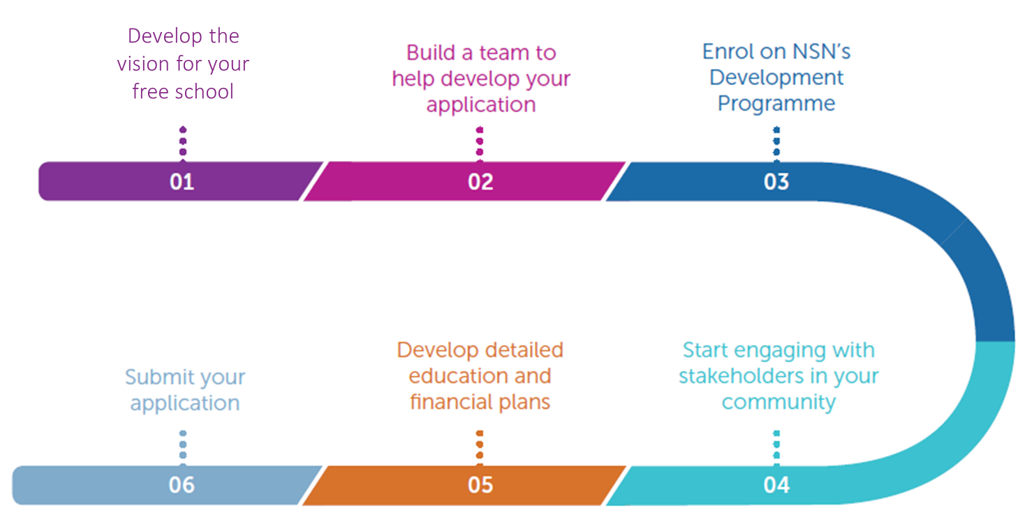
Application timeline
Pre-opening phase
Recruit staff, develop policies and curriculum, recruit pupils
Secure a site
Enrol onto NSN Pre-opening Programme
Support ad funding from DfE
Sign funding agreement

Slide 10
Lessons learnt

Slide 11
Developing a vision
A clear vision will act as the basis for all other activities related to your free school:
Vision
Building a team
Application development
Engaging the community

Slide 12
Presenting your vision
The DfE states that all applicants must:
explain your own vision for the proposed school, and how it will deliver the local authority’s specification;
explain how that vision comes across in your curriculum approach and approaches to meeting pupils’ special educational needs; and
ensure that your vision is evidence-based and consistent with the rest of your application – your overall application should clearly show the plan for implementing your vision.

Slide 13
The vision
Developing a clear vision involves thinking about these key elements:
Halton specification
School ethos and key features
Outcomes

Slide 14
Importance of a strong team
Applying for, setting up and opening a free school is an extremely demanding process. It’s essential that you have a strong, committed team with a wide range of skills working on the project.
Some of the challenges your team will face include:
Engaging with stakeholders and commissioners
Building a financial plan for the school
Designing a curriculum
Managing the project as a whole

Slide 15
Importance of a strong team
You must have the following:
Education expertise relevant to the type of school you want to set up
Finance expertise
Governance expertise
You should have the following:
Project management expertise
Marketing/communications expertise
Necessary for pre-opening:
HR expertise
ICT expertise
Buildings and sites
Legal expertise
Business/start up experience
Additional advisers
Steering group
Lead proposer

Slide 16
How New Schools Network can help you

Slide 17
How NSN can help you
Development Programme
A combination of the following:
A named personal NSN Adviser
A personalised support plan
Written feedback on draft applications
Specialist meetings
Networking with other free schools
Help marketing your school
Support for all groups
An hour long 1-1 meeting with one of our Advisers
Advice from the team via phone and email
A wide range of resources on our website.

Slide 18
NSN Development Programme
Feedback we have had from groups who have been on the programme has been overwhelmingly positive, and approval rates for groups on the programme shows its success.
“The Development Programme was excellent and offered appropriate support, challenges and rigour.”
100% of those who have received this additional support in the past said it was helpful
You are 50% more likely to be invited to interview.
“We couldn’t have done it without you! Thank you so much for keeping us on track and motivated.”
11 of the 14 successful free schools from the local authority-led special free school round wave 1 received NSN support.

Slide 19
Enrolling onto the DP
Book a 1-1 meeting with an adviser through our website.
Submit an enrolment form through our website
Contact NSN
Email: info@newschoolsnetwork.org
Phone: 020 7952 8558
Website: https://www.newschoolsnetwork.org/

Slide 20
Questions?

