Slide 1
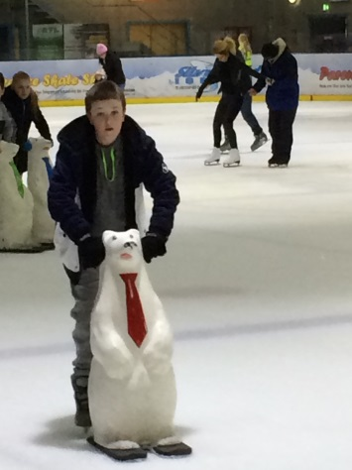
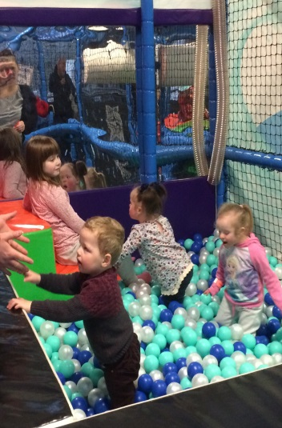
Silver Blades Ice Rink & Play Zone 16th February 2016
Halton Borough Council’s Disabled Children Service held a FREE family event at Silver Blades Ice Rink and Play Zone in Widnes on Tuesday 16th February.
This was a fun family activity held during the half-term school holiday attended by disabled children, their siblings (some of these are young carers) and their parent/carers. It allowed the children some time to play with their school friends and families to meet up socially during the school holidays.
Children and their families used the Ice Rink and the Dinky Rink using ice skates, Penguins and Polar Bears. Three Silver Blades coaches assisted children with extra help on the ice to have some fun. The Disabled Children Service and Portage were available to support any families that needed extra help.
Children had fun using the soft play activities in the Play Zone on the slides, climbing, in the ball pool and accessing sensory play. Families were provided with drinks and snacks. The events were really well attended and everyone had a fun, enjoyable family time together.
Parents provided the following comments…
It’s been great - like having our own party.
Thank you for organising everything in the school holiday.

